Slide 1
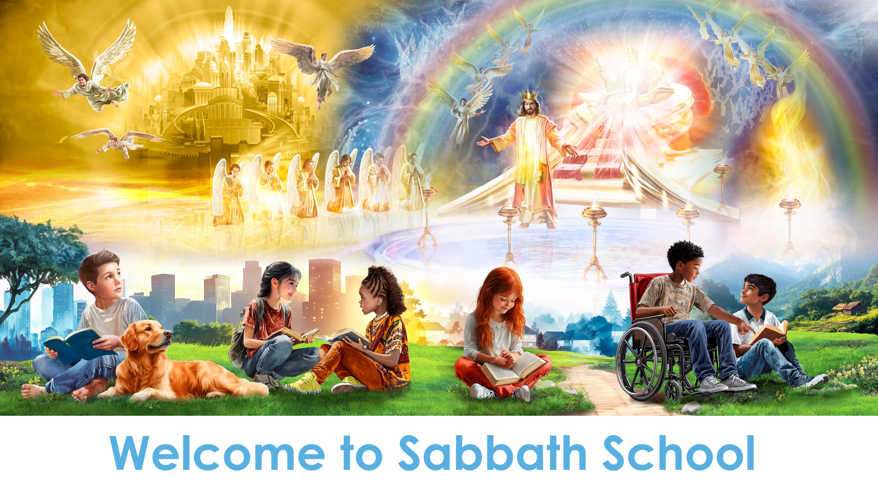

Slide 2
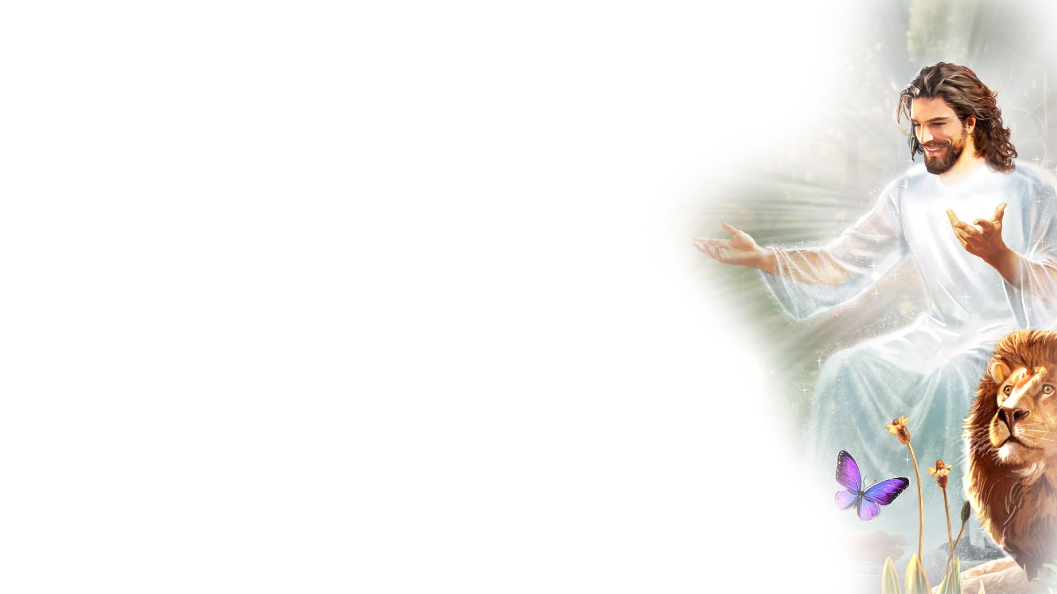
EARLY ARRIVALS
EARLY
ARRIVALS

Slide 3
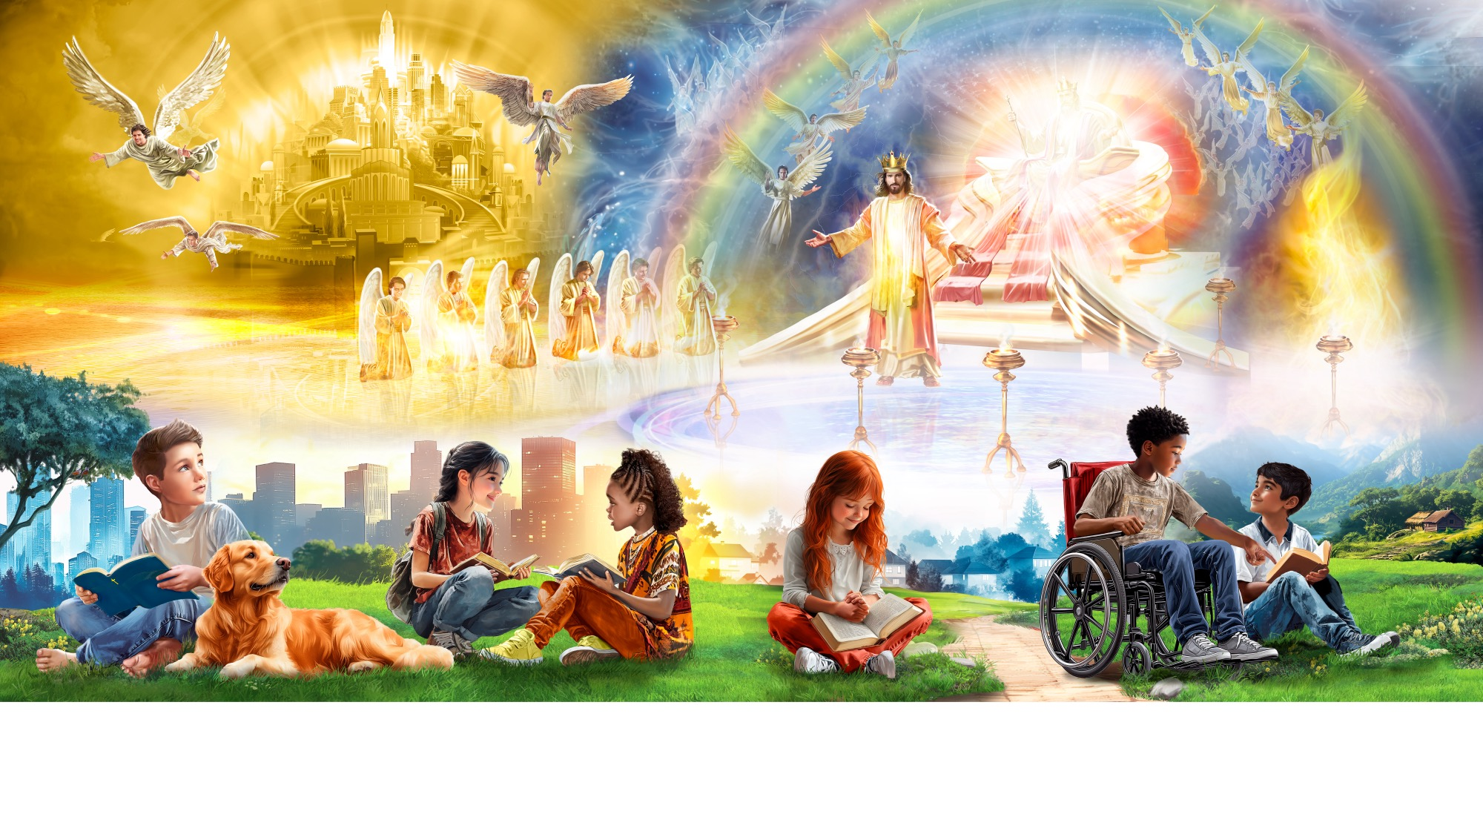
Welcome to Sabbath School

Slide 4
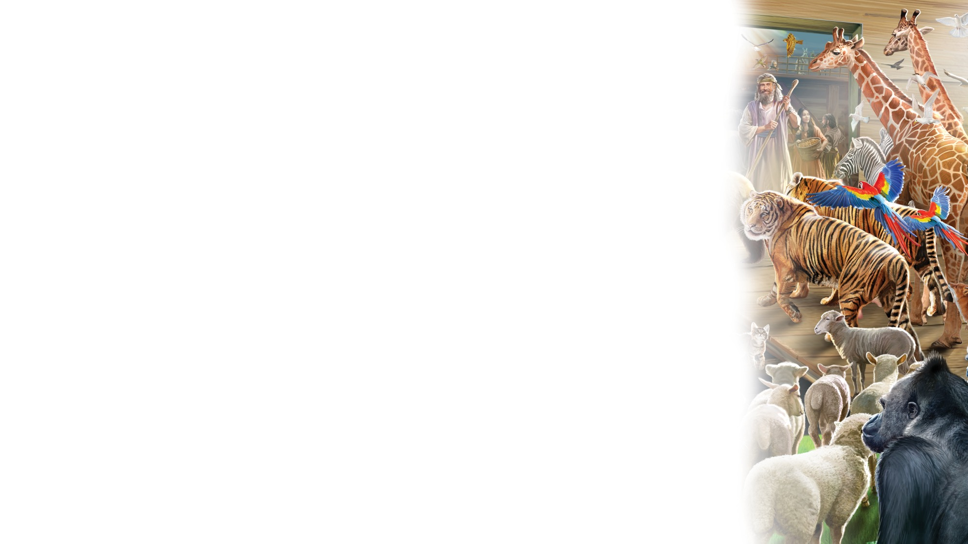

Alive in Jesus
OPENING ACTIVITIES
Welcome to Sabbath School.
It’s good to see you.
How are you today?
Let’s have some fun
As we learn about God’s love
And follow in His way.
We’re alive in Jesus.
We’re alive in Jesus.
(Repeat above)
“Alive in Jesus” by Rosie Smith. Copyright © 2024 General Conference Corporation® of Seventh-day Adventists.

Slide 5
God Is Our Creator
OPENING ACTIVITIES
God made the light,
And the stars and the moon.
He made the sky and the sea.
God made the trees and the animals, too,
And He made you and me.
God is our Creator.
Nature declares our Father’s care.
There is no one greater than our God.
(Repeat above)
“God Is Our Creator” by Rosie Smith. Copyright © 2024 General Conference Corporation® of Seventh-day Adventists.

Slide 6
Be still, Be Silent
OPENING ACTIVITIES
Be still, be silent as we talk
To the King of kings.
He knows and hears you;
You can tell Jesus anything.
(Repeat above)
Let’s close our eyes,
And kneel before our King.
Amen.
“Be Still, Be Silent” by Rosie Smith. Copyright © 2024 General Conference Corporation® of Seventh-day Adventists.

Slide 7

PRAYER
PRAYER

Slide 8

The Books of the Bible
BIBLE FOCUS
Let’s sing the books of the Bible.
Can you name all sixty-six?
Let’s sing the books of the Bible.
Sing with me, it goes like this…
Genesis, Exodus,
Leviticus, and Numbers,
Deuteronomy, Joshua,
Judges, and Ruth.
(Continued on next slide.)

Slide 9
The Books of the Bible
BIBLE FOCUS
First and Second Samuel,
First and Second Kings,
First and Second Chronicles,
Ezra, Nehemiah.
Esther, Job, and Psalms,
Proverbs, Ecclesiastes,
Song of Solomon,
Isaiah, Jeremiah.
(Continued on next slide.)

Slide 10
The Books of the Bible
BIBLE FOCUS
Lamentations, Ezekiel,
Daniel, Hosea,
Joel, and Amos,
Obadiah, and Jonah.
Micah, Nahum, Habakkuk, Zephaniah, and Haggai,
Zechariah, and Malachi.
We’ve just sung the first thirty-nine!
(Continued on next slide.)

Slide 11
The Books of the Bible
BIBLE FOCUS
Are you ready for the New Testament? Are you ready for the New Testament?
Matthew, Mark,
Luke, and John,
Acts, and Romans,
First and Second Corinthians,
Galatians, Ephesians,
Philippians, and Colossians,
(Continued on next slide.)

Slide 12
The Books of the Bible
BIBLE FOCUS
First and Second Thessalonians,
First and Second Timothy,
Titus, and Philemon.
Hebrews, and James,
First and Second Peter,
First, Second, and Third John,
Jude, and Revelation.
That’s twenty-seven more
And now we’re DONE!
“Books of the Bible” by Rosie Smith. Copyright © 2025 General Conference Corporation® of Seventh-day Adventists.

Slide 13
BIBLE FOCUS
BIBLE
FAST FACT

Slide 14

Thank You, Jesus
OFFERING
Thank you, Jesus,
For providing all my needs.
I want to give a little back
Of what you’ve given me.
Please bless our
Sabbath School offering.
May it bring You glory
And help others in need.
(Repeat above)
May it bring You glory
And help others in need.
“Thank You, Jesus” by Rosie Smith. Copyright © 2024 General Conference Corporation® of Seventh-day Adventists.

Slide 15
OFFERING
CHART &
MISSION
FAST FACT

Slide 16
Visitor Song
OPENING ACTIVITIES
We have a new friend
With us today.
We have a new friend.
Let’s smile and wave.
We welcome you to Sabbath School.
We’re glad you came.
We welcome you,
And hope to see you again. (x2)
“Visitor Song” by Rosie Smith. Copyright © 2024 General Conference Corporation® of Seventh-day Adventists.

Slide 17
Happy Birthday
OPENING ACTIVITIES
Happy birthday, happy birthday,
Happy birthday to you.
Jesus loves you dear ___________.
Happy birthday to you.
(Repeat above)
“Happy Birthday” by Janet Sage, copyright © 2001 North American Division Corporation of Seventh-day Adventists. From Little Voices Praise Him, #39. Used by permission.

Slide 18

FOCUS
ACTIVITIES

Slide 19

BIG IDEA
God gives me freedom
to choose
because
He is love.

Slide 20

BIBLE
STORY

Slide 21
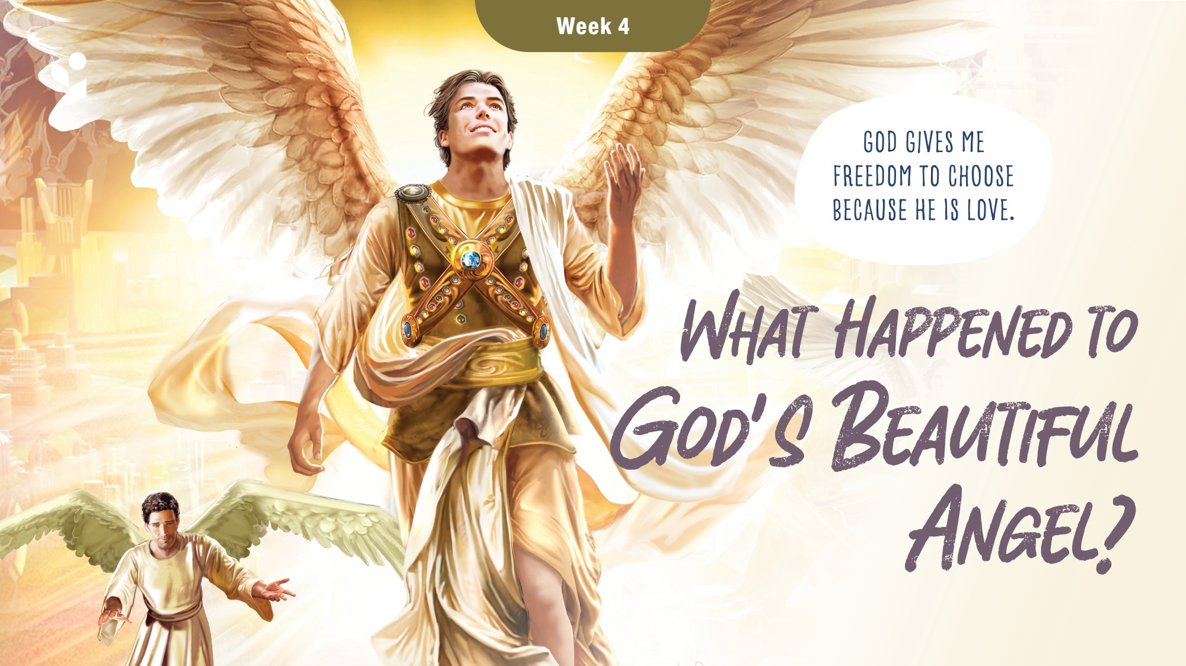

Slide 22
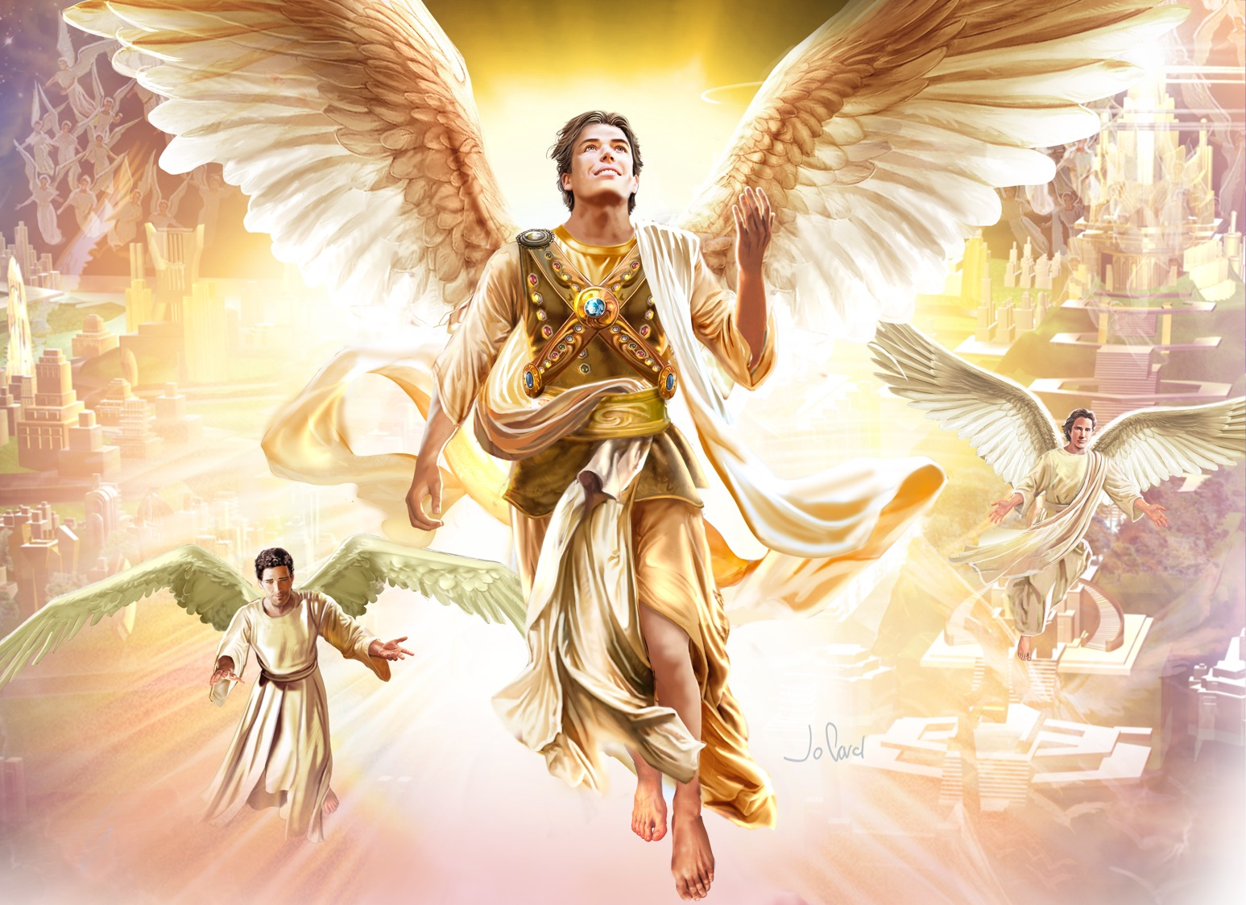

Slide 23
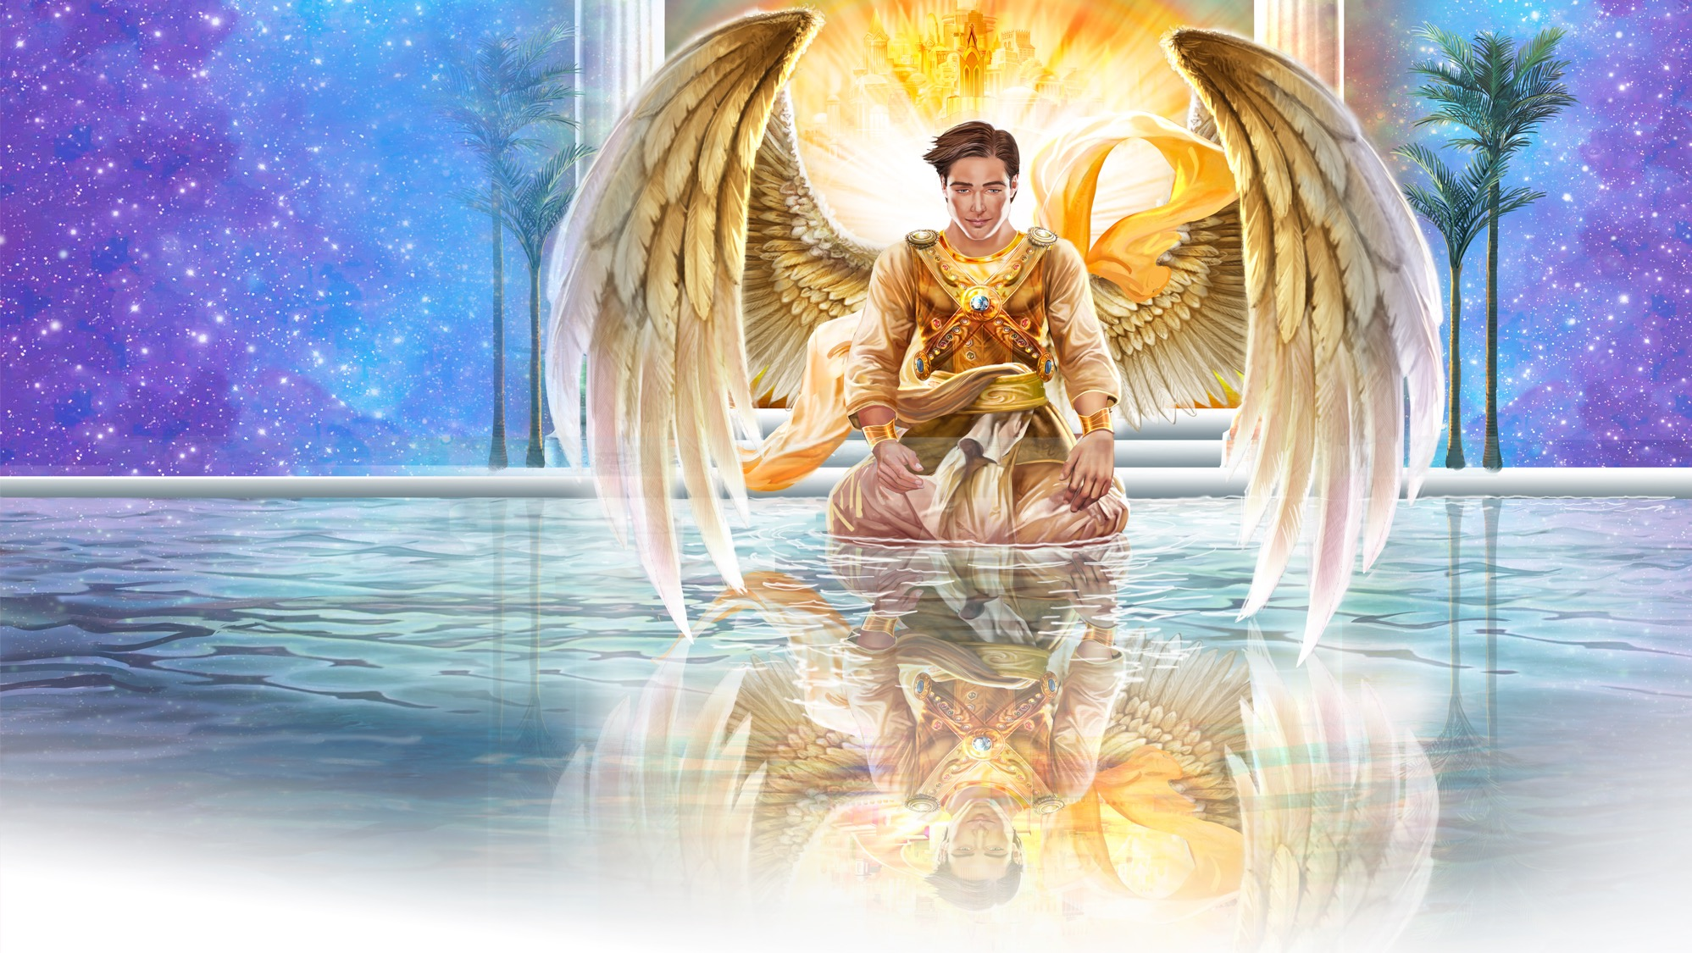

Slide 24
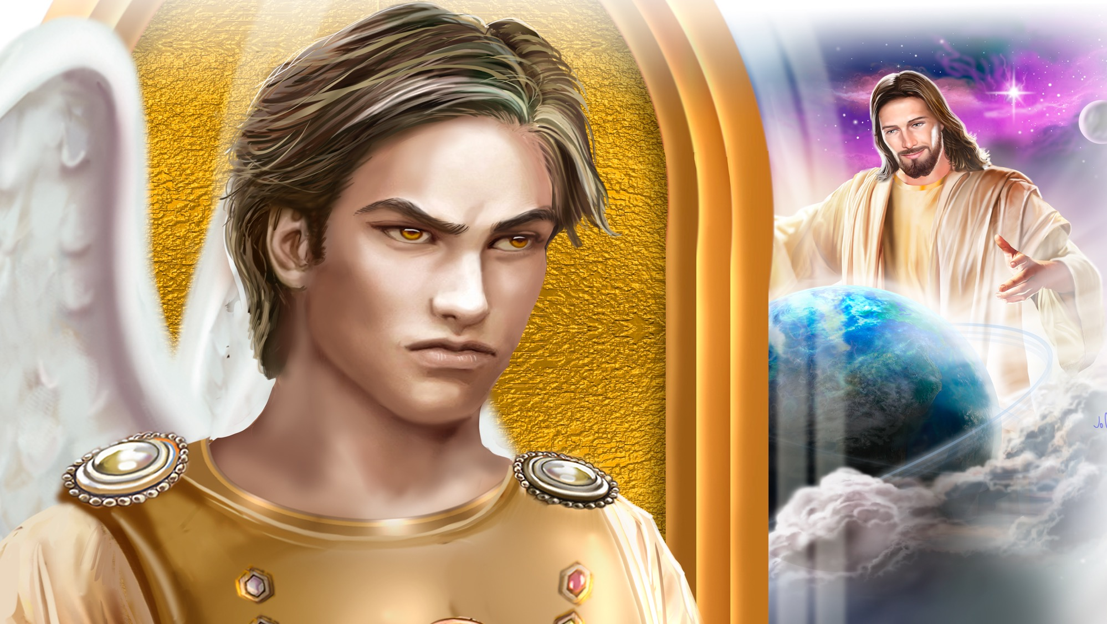

Slide 25
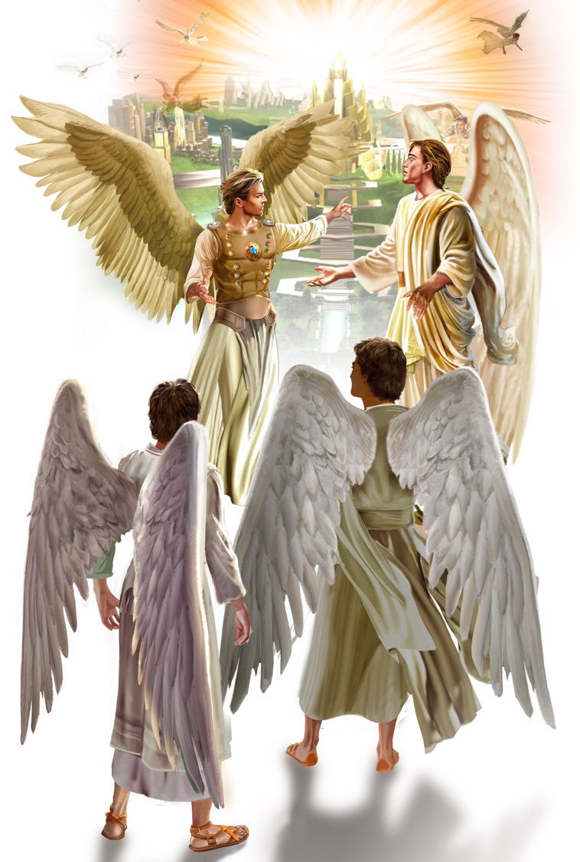

Slide 26
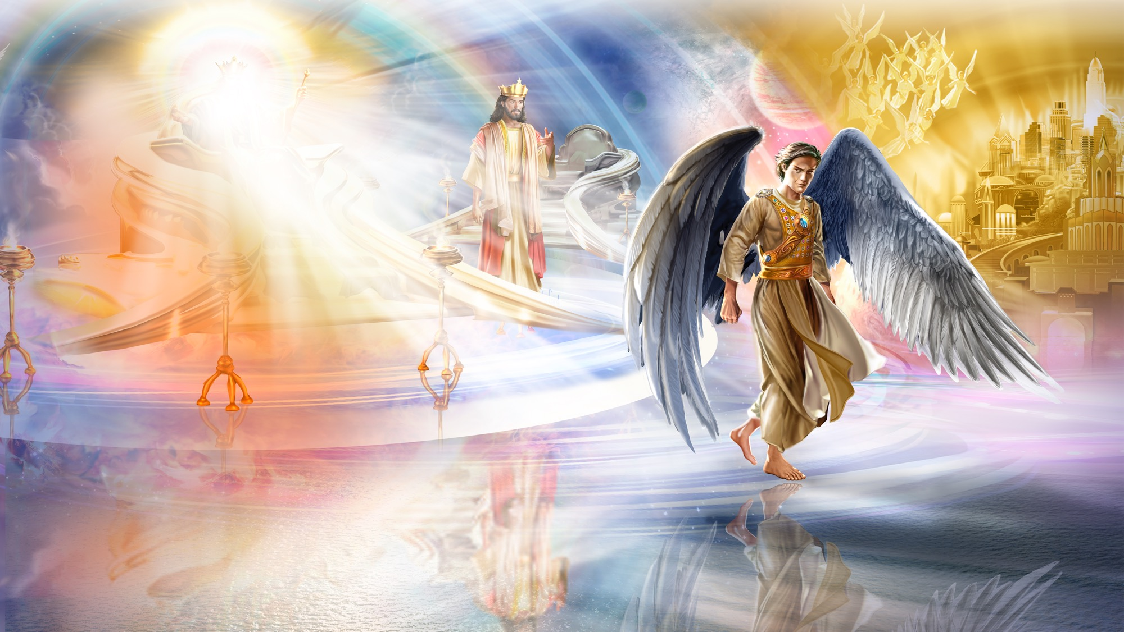

Slide 27
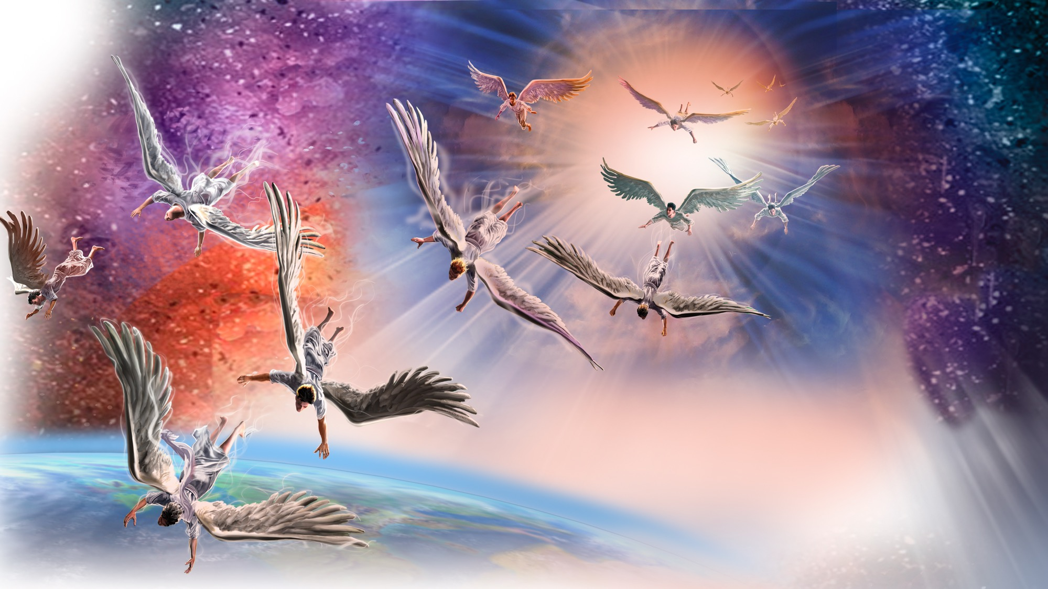

Slide 28
UNPACK
THE
STORY

Slide 29
Into My Heart
RESPOND
PRAYER
Into my heart, into my heart,
Come into my heart, Lord Jesus.
Come in today, come in to stay,
Como into my heart, Lord Jesus.
Out of my heart, out of my heart,
Shine out of my heart, Lord Jesus.
Shine out today, shine out always,
Shine out of my heart, Lord Jesus.
“Into My Heart” by Harry D. Clarke, copyright © Hope Publishing. From Little Voices Praise Him, #195. Used by permission.

Slide 30
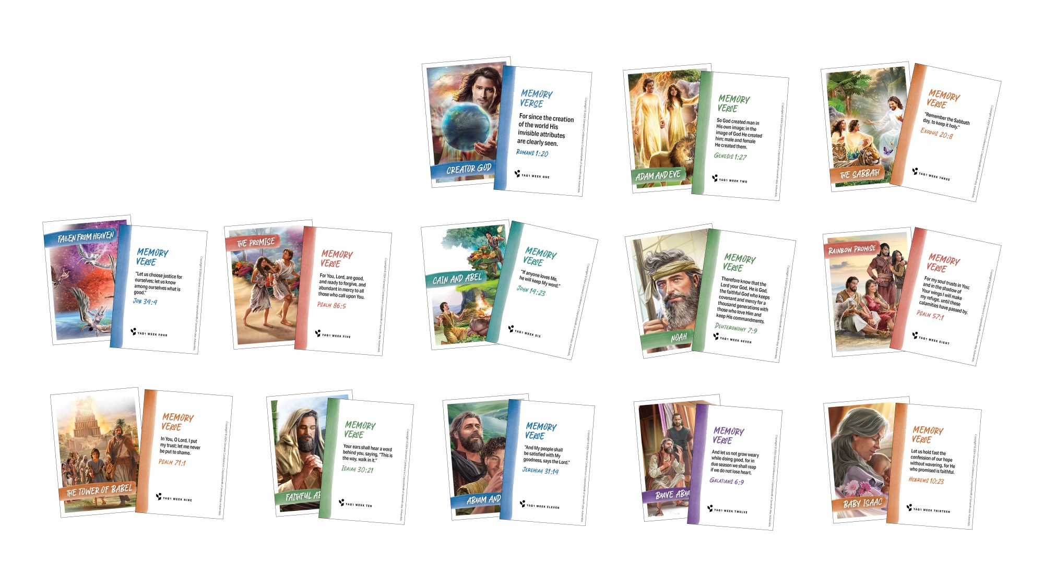
CHARACTER CARDS

Slide 31
MEMORY VERSE
Let us choose
justice for ourselves;
let us know
among ourselves what is good.
Job 34:4

Slide 32

NATURE
LESSON

Slide 33

CRAFT

Slide 34
COMMIT

Slide 35

God Bless You
CLOSING SONG
What did you enjoy today?
What did you learn that’s new?
It’s time for us to say:
“Goodbye, and see you soon!”
What did you enjoy today?
What did you learn that’s new?
It’s time for us to say:
“Goodbye, and see you soon!”
(Continued on next slide.)

Slide 36
God Bless You
CLOSING SONG
We’ll see you again,
So until then,
God bless you.
We’ll see you again,
So until then,
God bless you.
God bless YOU!
“God Bless You” by Rosie Smith. Copyright © 2025 General Conference Corporation® of Seventh-day Adventists.

Slide 37

MISSION
CHALLENGE

Slide 38
PRAYER
PRAYER

